Slide 1
FAKE NEWS CLASSIFICATION USING NLP
MINOR PROJECT
PRESENTED BY: AVINEET JENA - 2029011
SUJAL KUMAR - 2029036
PRANJAL SINHA- 2029166
SANDESH TRIPATHI - 2029213

Slide 2
INTRODUCTION
With a growing amount of time spent online on social media, people are increasingly relying on these platforms as a source of news rather than traditional media outlets.
However, the quality of news on social media is lower than that of traditional news organizations.
False information based on rumours or misconceptions are
sometimes circulated among the masses to sway their opinions. Thus, it is important to develop methods to automatically detect fake news online to help minimize its regulation.

Slide 3
PROBLEM STATEMENT
The problem of fake news detection on social media is characterized by the intentional spread of false information, making it difficult to detect based solely on the news content. The existing news media detection methods fail to detect it accurately.
To identify fake news, additional information like user's social engagement on social media is required as the fake news is designed to deceive the reader with false information.

Slide 4
PROJECT PLANNING
We are undertaking a project that involves analyzing two datasets: genuine news articles and fake news articles.
The datasets consist of around 35,000 news stories, with an equal number of stories classified as true or false.
The real news articles are sourced exclusively from Reuters and
The Guardian, while the origin of the fake news articles is unknown.
Our first step is to import necessary libraries and the Natural
Language Tool Kit. Then, we will load the datasets.

Slide 5
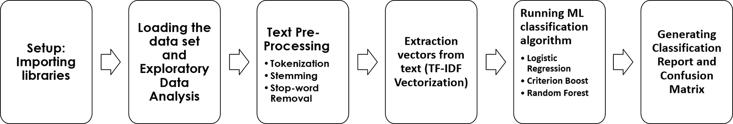
SYSTEM ARCHITECTURE

Slide 6
METHODOLOGIES USED
PCA- Principal Components Analysis (PCA) Dealing with noise
Supervised Learning-Directed/Supervised learning: Classification and regression in which output is known. KNN - K-Nearest Neighbour is one of the simplest Machine
Learning algorithms based on Supervised Learning technique.
Bayes Theorem
Naïve Bayes Classifier NLP and it’s Libraries

Slide 7

IMPLEMENTATION
Pre-processing of Data :
Removing Stopwords, Punctuations
Tokenization, Stemming and Lemmatization
Converting words to lowercase Feature Extraction :
Bag of Words (BoW)
TF-IDF
Count Vectorizer

Slide 8
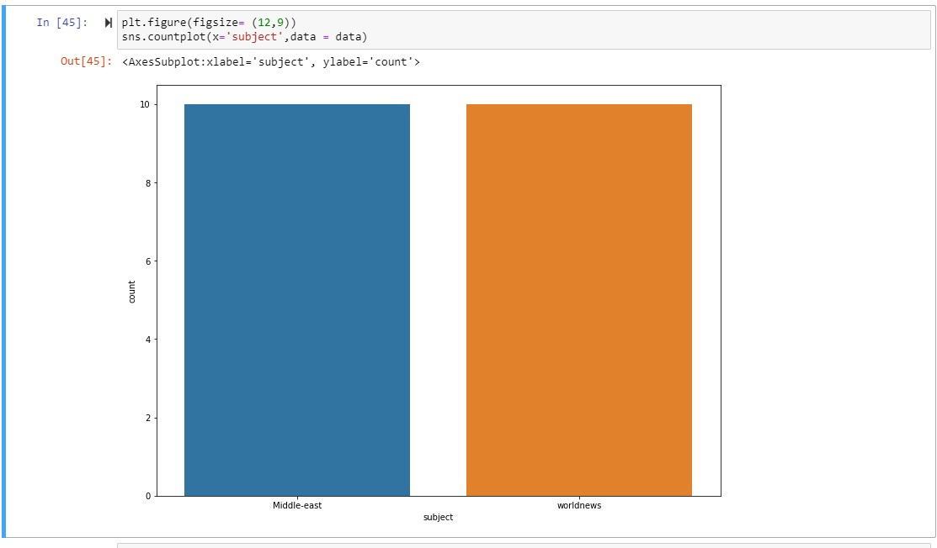
RESULT & ANALYSIS

Slide 9
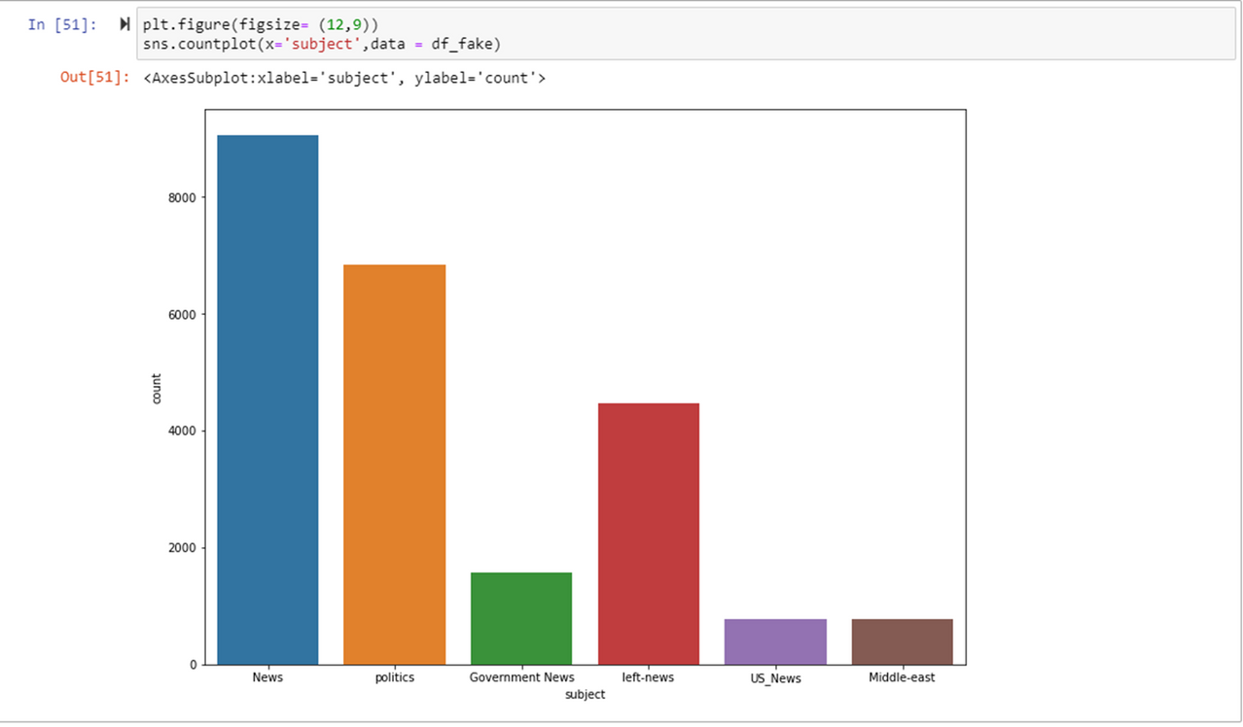
RESULT & ANALYSIS

Slide 10
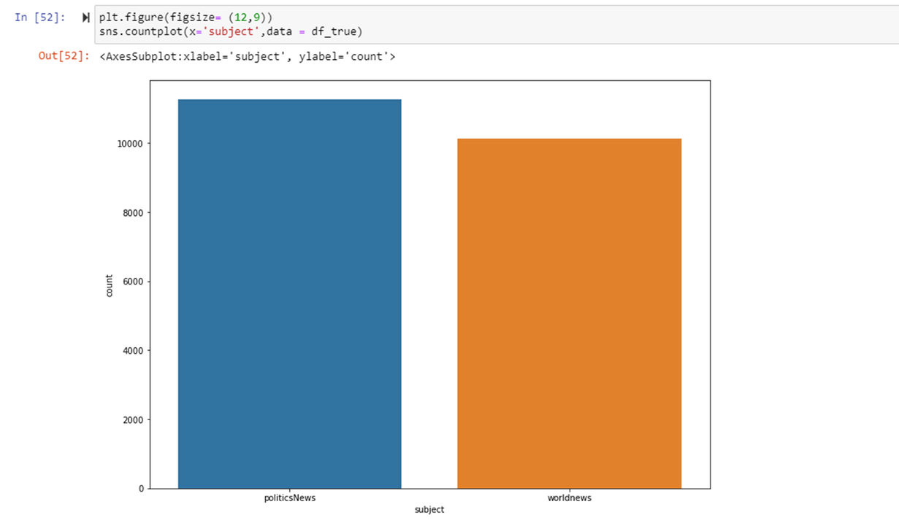
RESULT & ANALYSIS

Slide 11
CONCLUSION
Fake News has been a concern all over the world and social media has only amplified this phenomenon.
The research thus proposes the approach to classify the news article into fake or legitimate using NLP.
In the first stage, the fundamental ideas and concepts
regarding fake news in social media are emphasized.
During the research stage, the existing techniques for detecting fake news through the use of various supervised learning algorithms are analyzed and reviewed.

Slide 12
FUTURE SCOPE
Finally, the goal is to classify Fake News on social media and move closer to building an automated Fake News Detection System.
This study provides a foundation for future research and broadens the possibilities for addressing the problem of Fake News Detection.
The research can also incorporate successful models from other
fields and re-assess the feature engineering and preprocessing techniques used.

Slide 13
THANK YOU !
AVINEET JENA: 2029011
SUJAL KUMAR : 2029036
PRANJAL SINHA : 2029166
SANDESH TRIPATHI : 2029213

